Slide 1







About this course
Azure storage solutions
Azure SQL Database Azure Blob Storage
Azure Data Lake Storage Gen2
Other Bigdata Solutions
Azure Data Factory (ADF)
Azure Databricks
Azure HDInsight
Reporting Technologies
PowerBI

Slide 2

Covid-19 Prediction/ Reporting

Slide 3











Covid-19 Prediction/ Reporting
Data Warehouse
Data Transformation
Data Sources
Data Lake
Data Integration/ Transformation/ Orchestration

Slide 4
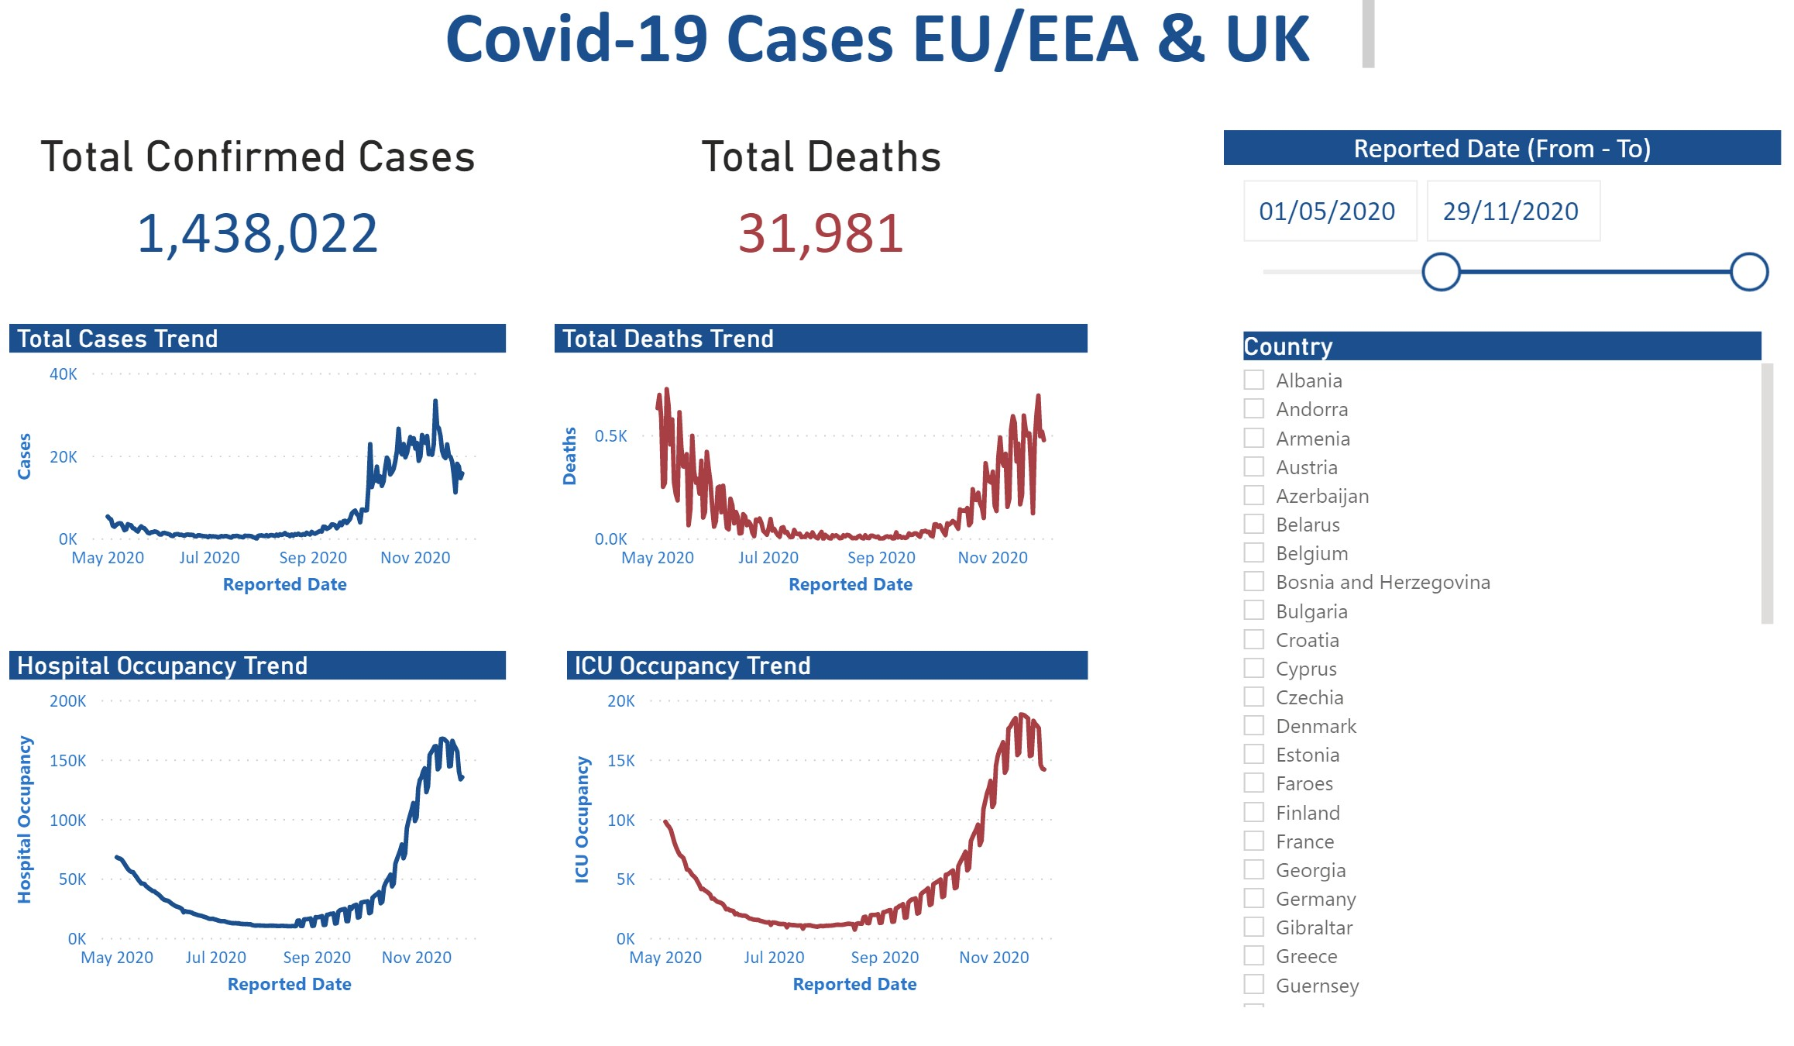
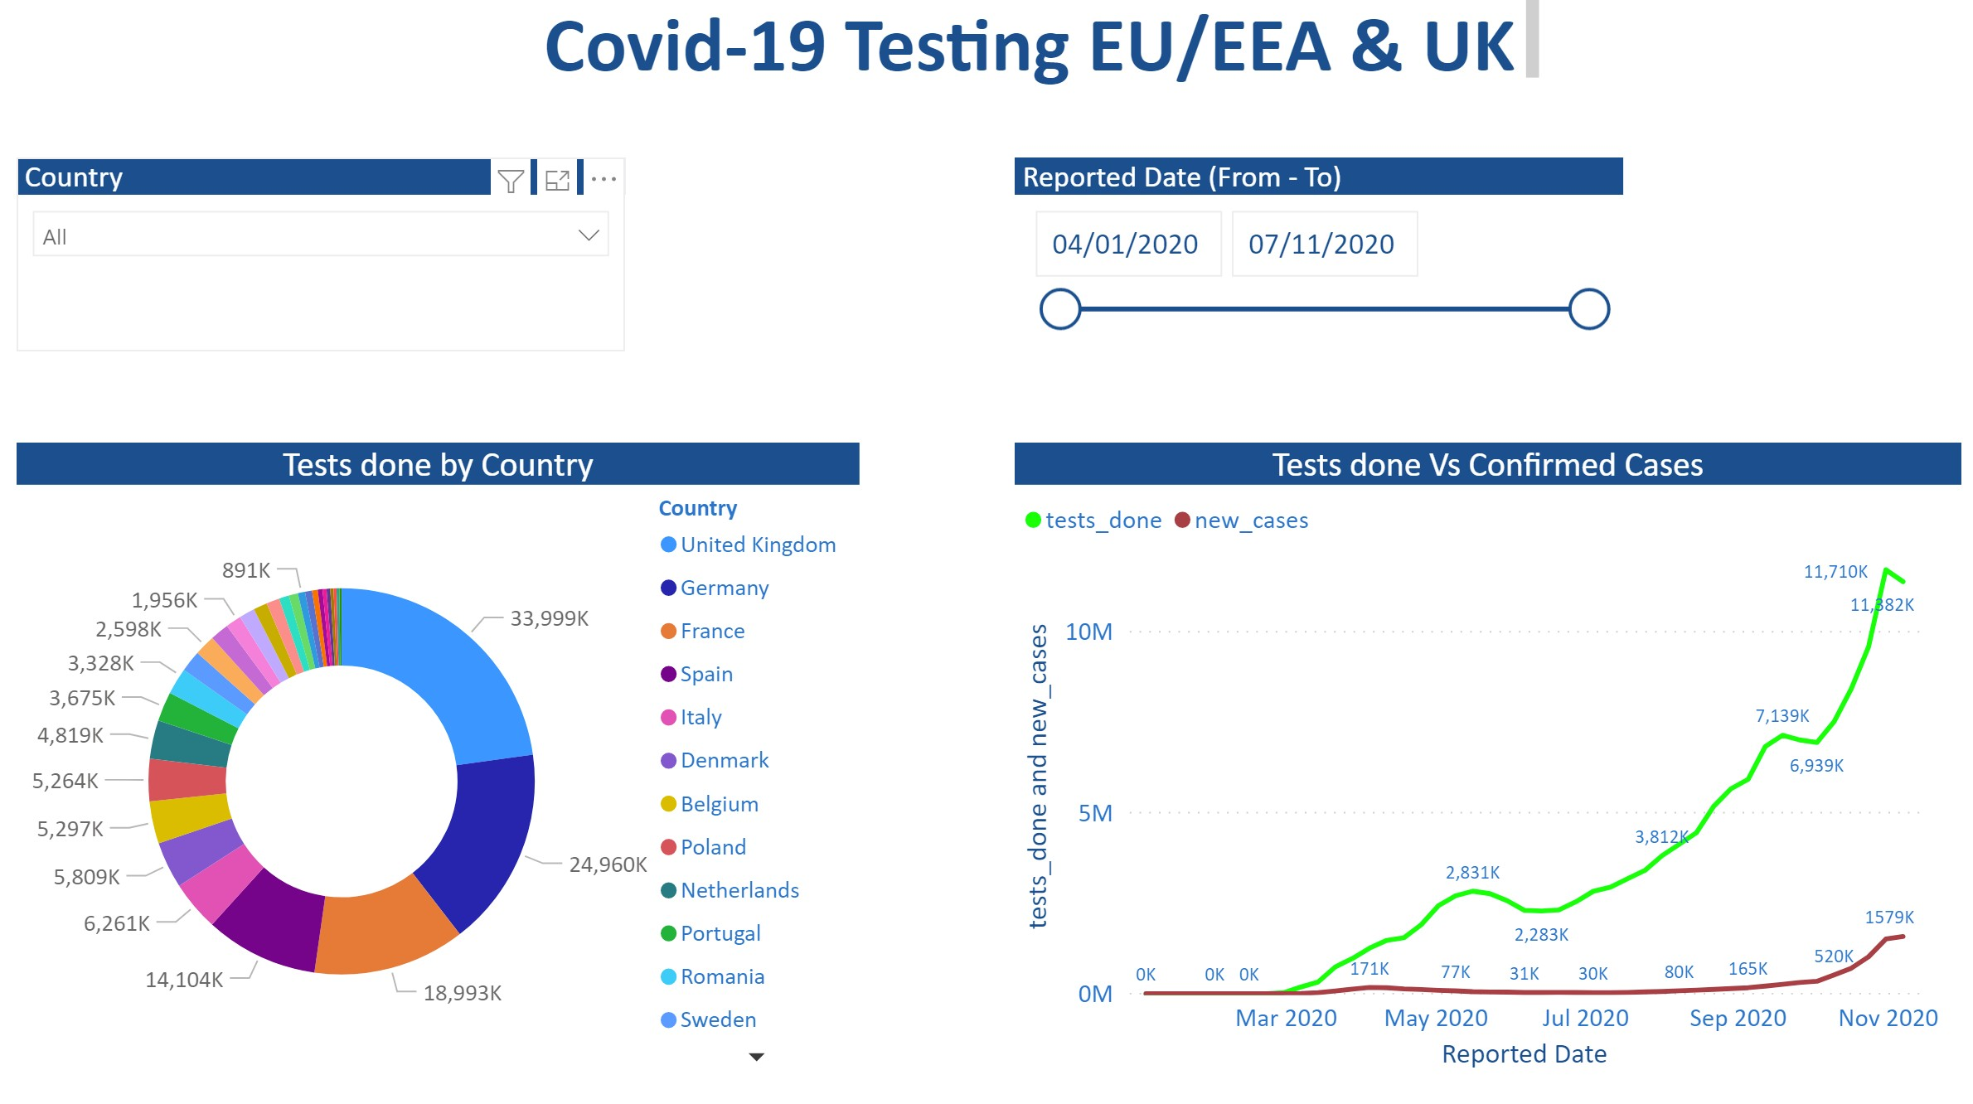
Covid-19 Prediction/ Reporting

Slide 5
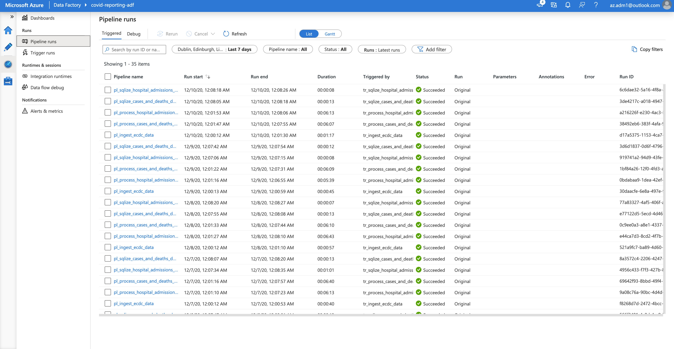
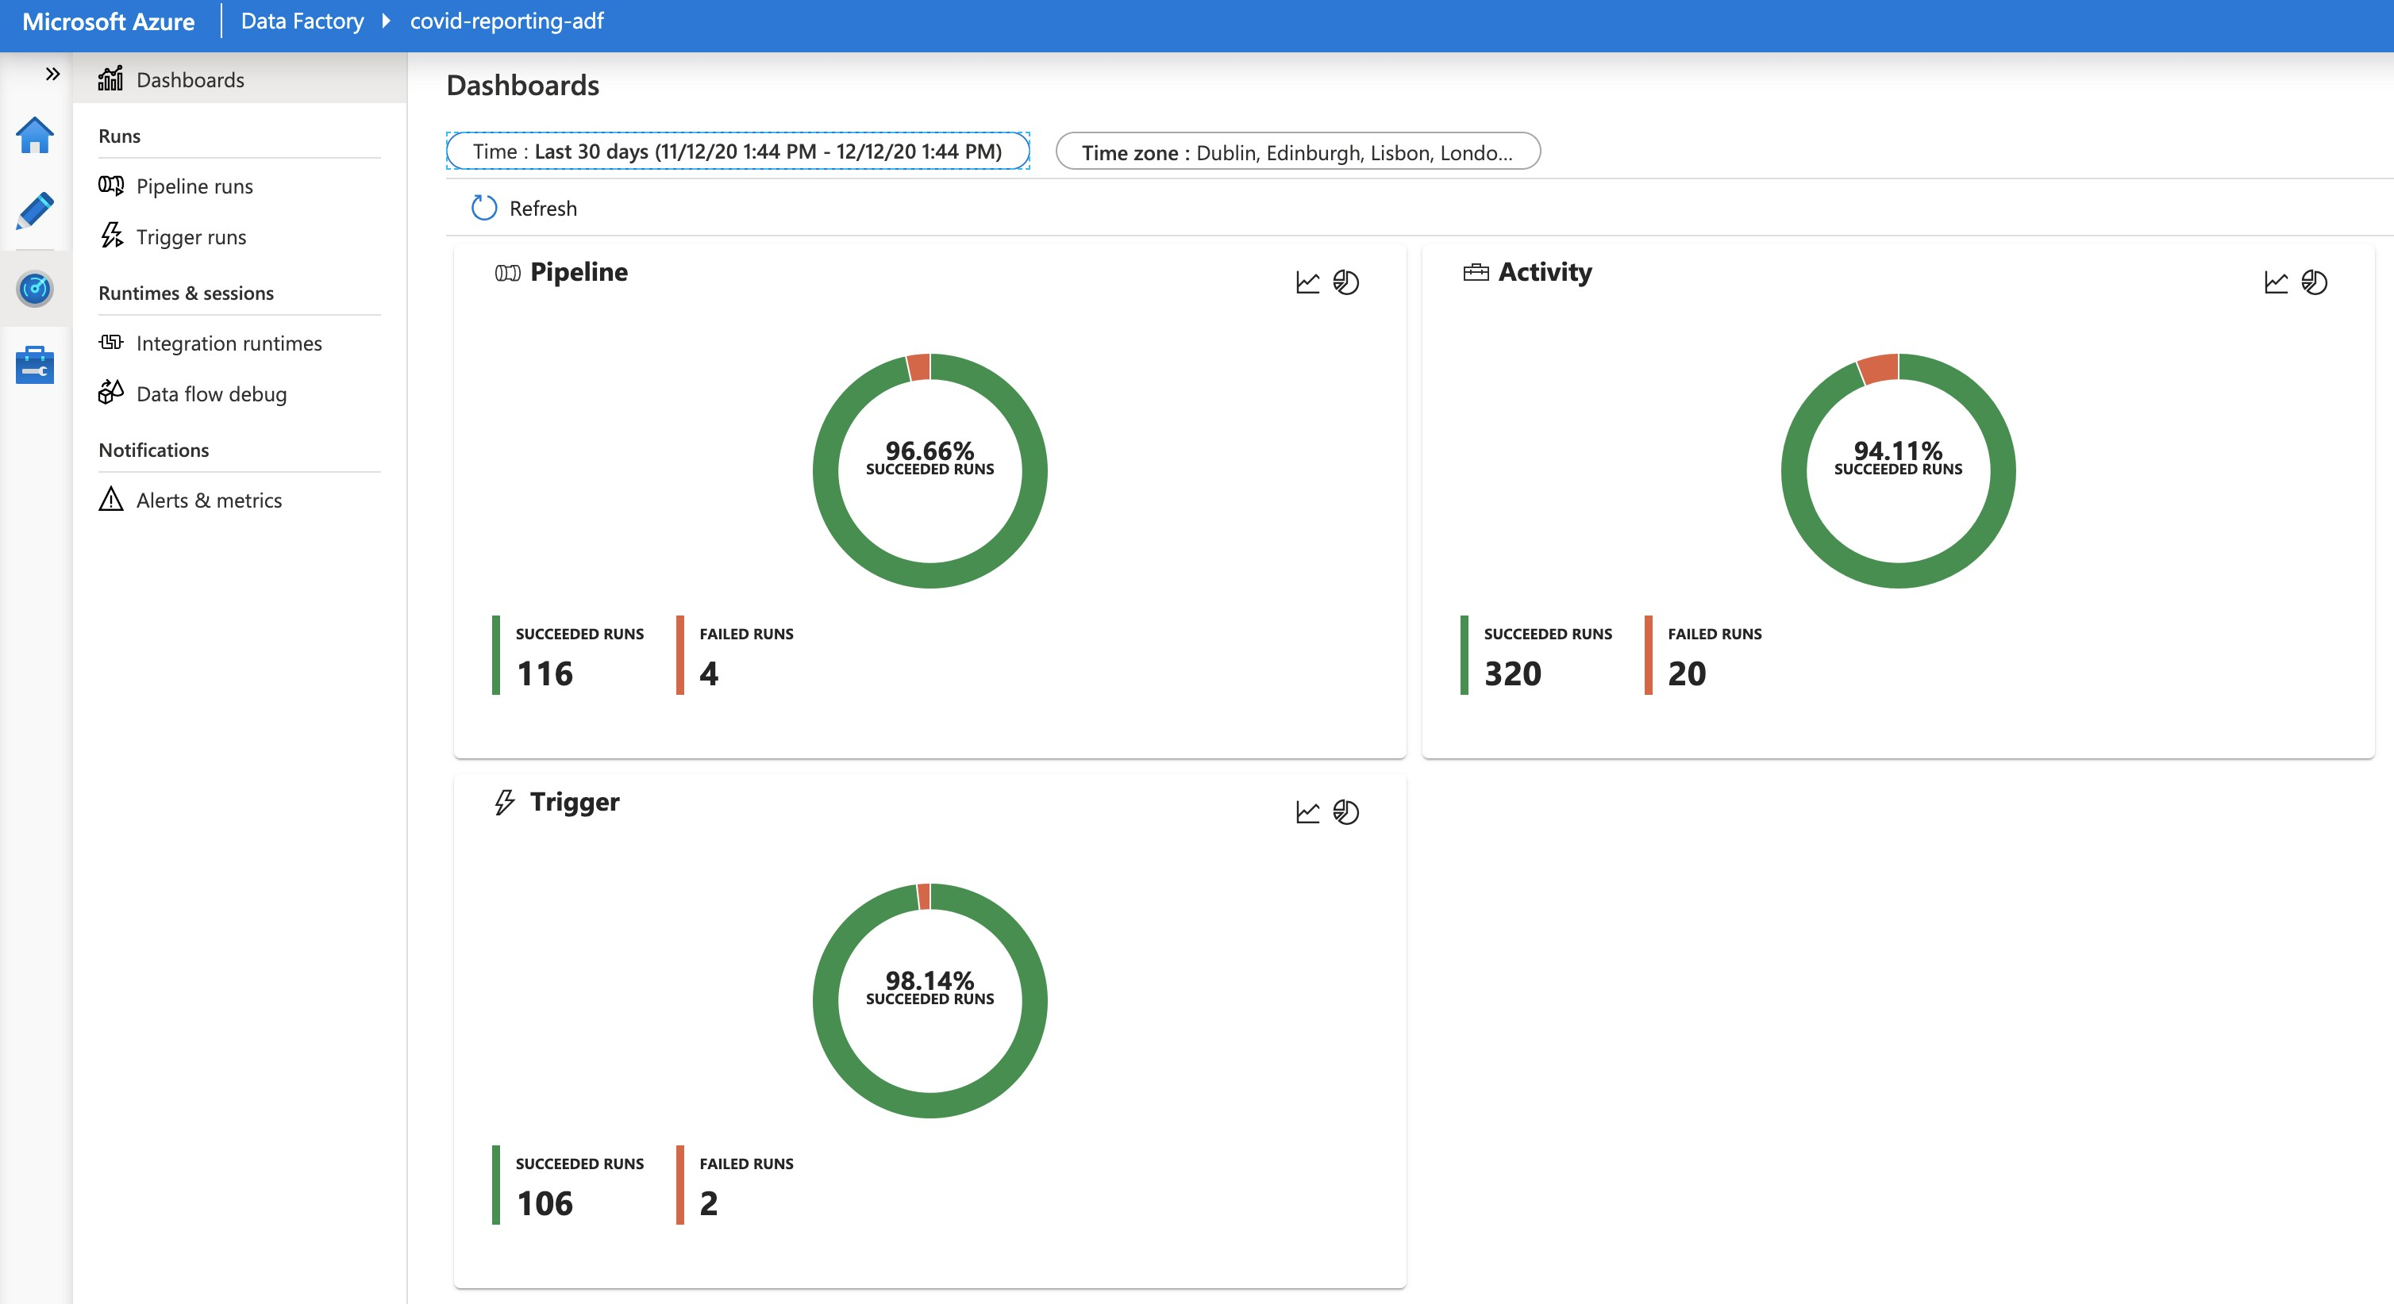
Covid-19 Prediction/ Reporting

Slide 6
Course Structure
Ingestion
Transformation
Copy
Exploitation
6.Data Flow (1)
4.Ingestion - Blob
7.Data Flow (2)
2.Overviews
3.Environment Set-up
8.Data Prep
11.Copy to SQL
14.Power BI
5.Ingestion - HTTP
9.HDInsight
10.Databricks
12.Orchestration
13.Monitoring

Slide 7
Covid-19 Prediction/ Reporting

Slide 8
Azure Data Factory Overview

Slide 9

What is Azure Data Factory
A fully managed, serverless data integration solution for ingesting, preparing and transforming all of your data at scale.

Slide 10














The Data Problem
Multi Cloud
SaaS Apps
Data Formats
On Premises

Slide 11














The Data Problem
 | Ingest
 | Transform/ Analyze
 | Publish
Data Consumers
Data Sources

Slide 12

The Data Problem
 | Ingest
 | Transform/ Analyze
 | Publish
Data Consumers
Data Sources

Slide 13
The Data Problem
 | Ingest
 | Transform/ Analyze
 | Publish
Data Consumers
Data Sources

Slide 14
The Data Problem
 | Ingest
 | Transform/ Analyze
 | Publish
Data Consumers
Data Sources

Slide 15
The Data Problem
 | Ingest
 | Transform/ Analyze
 | Publish
Data Consumers
Data Sources

Slide 16

What is Azure Data Factory
Fully Managed Service
Serverless
Data Integration Service Data Transformation Service Data Orchestration Service
A fully managed, serverless data integration solution for ingesting, preparing and transforming all of your data at scale.

Slide 17
What Azure Data Factory Is Not
Data Migration Tool
Data Streaming Service
Suitable for Complex Data Transformations Data Storage Service

Slide 18
Project Overview

Slide 19
Covid-19 Prediction/ Reporting

Slide 20

Data Lake
Data Lake to be built with the following data to aid Data Scientists to predict the spread of the virus/ mortality
Confirmed cases
Mortality
Hospitalization/ ICU Cases Testing Numbers
Country’s population by age group

Slide 21
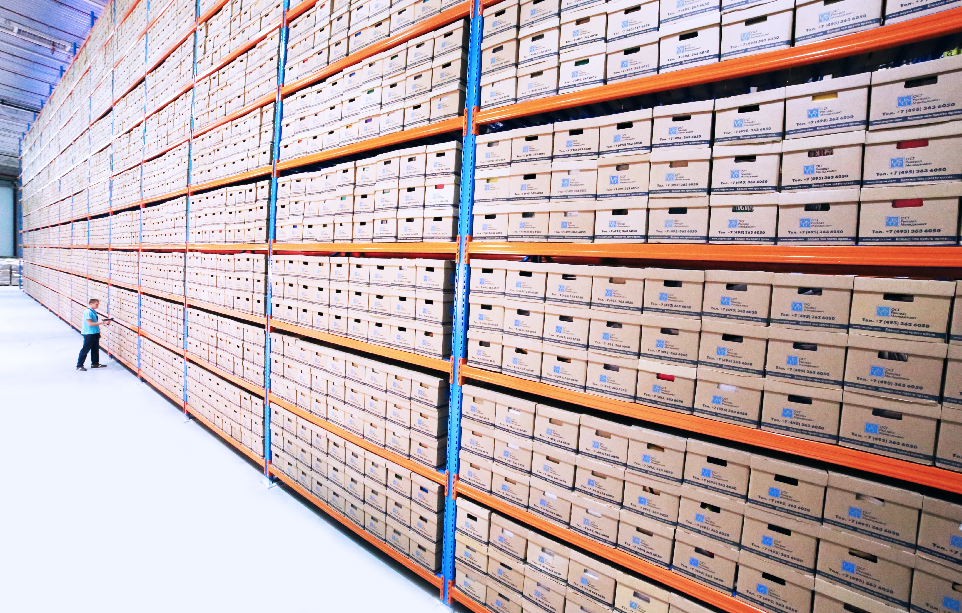
Data Warehouse to be built with the following data to aid Reporting on Trends
Data Warehouse
Confirmed cases
Mortality
Hospitalization/ ICU Cases Testing Numbers

Slide 22

Data Sources
ECDC Website
Confirmed cases
Mortality
Hospitalization/ ICU Cases Testing Numbers
Eurostat Website
Population by age

Slide 23
Solution Architecture

Slide 24











Solution Architecture
Transformation
ECDC COVD-19
data (HTTP Connector)
Ingest
Transform/ Analyze
Publish
Azure Data Lake Storage Gen2
Azure SQL Database
Population Data (Azure Blob Storage)
Azure Data Lake Storage Gen2
ML Models

Slide 25
Solution Architecture
Transformation
ECDC COVD-19
data (HTTP Connector)
Ingest
Transform/ Analyze
Publish
Azure Data Lake Storage Gen2
Azure SQL Database
Population Data (Azure Blob Storage)
Azure Data Lake Storage Gen2
ML Models

Slide 26
Solution Architecture
Transformation
ECDC COVD-19
data (HTTP Connector)
Ingest
Transform/ Analyze
Publish
Azure Data Lake Storage Gen2
Azure SQL Database
Population Data (Azure Blob Storage)
Azure Data Lake Storage Gen2
ML Models

Slide 27
Solution Architecture
Transformation
ECDC COVD-19
data (HTTP Connector)
Ingest
Transform/ Analyze
Publish
Azure Data Lake Storage Gen2
Azure SQL Database
Population Data (Azure Blob Storage)
Azure Data Lake Storage Gen2
ML Models

Slide 28
Storage Solutions

Slide 29
Key Factors to Consider
Structure of the data
Structured
Semi-Structured
Unstructured
Operational needs
How often is the data accessed?
How quickly do we need to serve? Need to run simple queries?
Need to run heavy analytical workload? Accessed from multiple regions?

Slide 30





Azure Databases
Azure SQL Database
Azure Database for MySQL Azure Database for PostgreSQL Azure Database for MariaDB
VM Images with Oracle, SQL Server etc.

Slide 31





Azure Storage Account
Blob Storage
File Storage Disk Storage Table Storage Queue Storage

Slide 32

Azure Data Lake
Azure Data Lake Storage Gen2
Enhance Performance
Better Security
Enhance Management

Slide 33

Azure Cosmos DB
Globally distributed
Multi Model High Throughput

Slide 34



Storage solutions used in this course
Azure SQL Database
Azure Blob Storage
Azure Data Lake Storage Gen2

Slide 35
Environment set-up

Slide 36
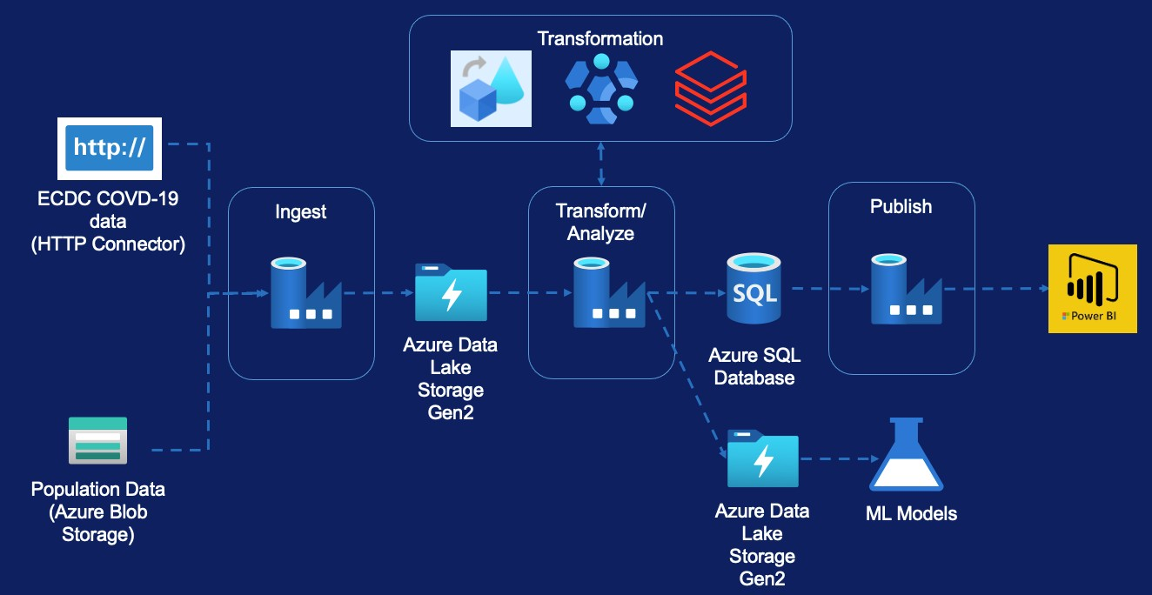
Environment set-up
Azure Subscription
Data Factory
Blob Storage Account Data Lake Storage Gen2 Azure SQL Database
Azure Databricks Cluster
HD Insight Cluster

Slide 37

Creating Azure Free Account

Slide 38
Creating Azure Data Factory

Slide 39

Creating Azure Storage Account

Slide 40
Creating Azure Data Lake Gen2

Slide 41
Creating Azure SQL Database

Slide 42
Data Ingestion

Slide 43
Data Ingestion - Module Overview (Population by Age)

Slide 44
Data Ingestion – Population Data
Transformation
ECDC COVD-19
data (HTTP Connector)
Ingest
Transform/ Analyze
Publish
Azure Data Lake
Azure SQL Database
Storage Gen2
Population Data (Azure Blob Storage)
Azure Data Lake Storage Gen2
ML Models

Slide 45
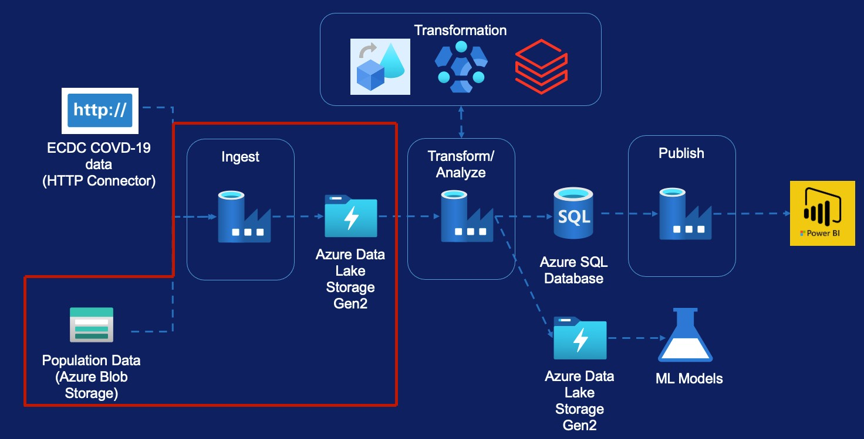
Data Ingestion – Population Data
Copy Activity
Linked Services Datasets Pipeline
Validation Activity If Condition Activity Web Activity
Get Metadata Activity Delete Activity Trigger

Slide 46
Copy Activity
Azure Blob Storage
Azure Data Lake

Slide 47

Copy Activity
Ingest ”population by age” for all EU Countries into the Data Lake to support the machine learning models to predict increase in Covid-19 mortality rates

Slide 48




Copy Activity
Source
Target
Storage Account – covidreportingsa Container – population
File - population_by_age.tsv.gz
Copy & Extract
Storage Account – covidreportingdl Container – raw
File -
population/population_by_age.tsv
Data Sourced from - https://ec.europa.eu/eurostat/tgm/table.do?tab=table&plugin=1&language=en&pcode=tps00010

Slide 49



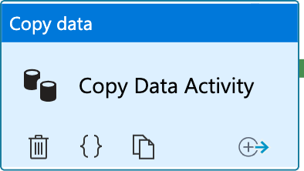

Copy Activity
Source
Sink
Azure Blob Storage
Azure Data Lake
Source File (Zipped TSV)
Target File (TSV)
Copy Activity

Slide 50


Copy Activity
Source
Sink
Azure Blob Storage
Azure Data Lake
Source File (Zipped TSV)
Target File (TSV)
Source Data Set
Copy Activity
Sink Data Set

Slide 51


Copy Activity
Source
Sink
Azure Blob Storage
Linked Service
Linked Service
Azure Data Lake
Source File (Zipped TSV)
Target File (TSV)
Source Data Set
Copy Activity
Sink Data Set

Slide 52

Copy Activity
Pipeline
Source
Sink
Azure Blob Storage
Linked Service
Linked Service
Azure Data Lake
Source File (Zipped TSV)
Target File (TSV)
Source Data Set
Copy Activity
Sink Data Set

Slide 53

Copy Activity From Azure Blob Storage

Slide 54








Copy Activity
Pipeline
5
Source
Sink
1
ls_ablob_covidreportingsa
2
ds_population_raw_gz
1
3
Linked Service
Azure Blob Storage
Linked Service
Azure Data Lake
3
ls_adls_covidreportingdl
4
ds_population_raw_tsv
Source File (Zipped TSV)
2
4
Target File (TSV)
Source Data Set
Copy Activity
6
Sink Data Set
5
pl_ingest_population_data
Storage Account: covidreportingdl Container: raw
File: population/population_by_age.tsv
6
Copy Population Data
Storage Account: covidreportingsa Container: population
File: population_by_age.tsv.gz

Slide 55
Handling Real World Scenarios

Slide 56
Scenario 1
Execute Copy Activity when the file becomes available

Slide 57
Scenario 2
Execute Copy Activity only if file contents are as expected

Slide 58
Scenario 3
Delete the source file on successful copy

Slide 59
Scheduling Pipeline Execution

Slide 60






Schedule Trigger
Triggers
Tumbling Window Trigger
Event Trigger

Slide 61






Runs on a calendar/ Clock
Supports periodic and specific times
Schedule Trigger
Trigger to Pipeline is Many to Many
Can only be scheduled for a future time to start

Slide 62






Runs at periodic intervals
Windows are fixed sized, non-overlapping
Tumbling Window Trigger
Can be scheduled for the past windows/ slices
Trigger to Pipeline is one to one

Slide 63













Runs in response to events
Events can be creation or deletion of Blobs/ Files
Event Trigger
Trigger to Pipeline is Many to Many

Slide 64
Data Ingestion - Module Overview (ECDC Data)

Slide 65
Data Ingestion – ECDC Data
Transformation
ECDC COVD-19
data (HTTP Connector)
Ingest
Transform/ Analyze
Publish
Azure Data Lake Storage Gen2
Azure SQL Database
Population Data (Azure Blob Storage)
Azure Data Lake Storage Gen2
ML Models

Slide 66
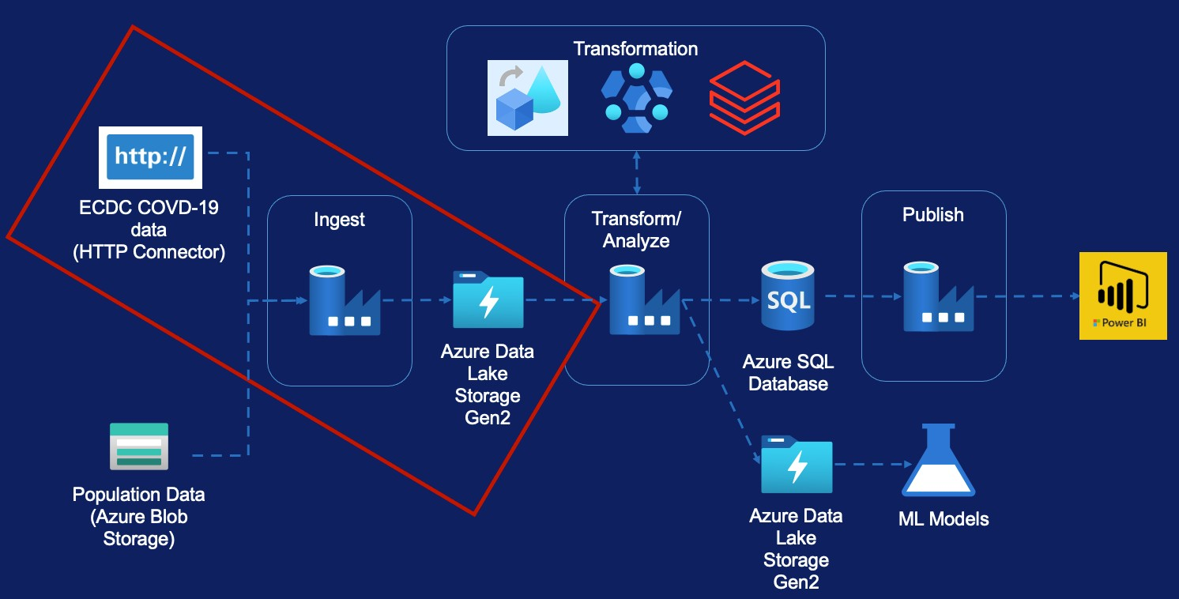
Data Ingestion – ECDC Data
ECDC Data Overview
Create Initial Pipeline
Pipeline Variables Pipeline Parameters Lookup Activity
For Each Activity
Linked Service Parameters Metadata driven pipeline

Slide 67
Recent Changes to ECDC Data

Slide 68
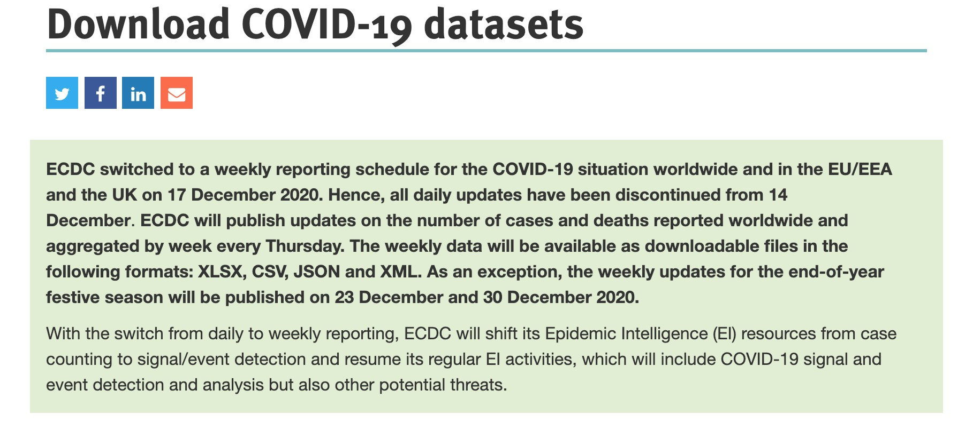
Recent Changes to ECDC Data
Granularity of the data changed from daily to weekly
File structure is also different as a result
Use GIT Repo - https://github.com/sateeshcloud/mydatasets

Slide 69
Data Ingestion
HTTP
Azure Data Lake

Slide 70
Data Ingestion Requirements
Covid-19 new cases and deaths by Country
Covid-19 Hospital admissions & ICU cases Covid-19 Testing Numbers
Country Response to Covid-19
URL - https://www.ecdc.europa.eu/en/covid-19/data

Slide 71
Data Ingestion
Case & Deaths Data
URL - https://www.ecdc.europa.eu/en/publications-data/data-national-14-day-notification-rate-covid-19

Slide 72




Copy Activity – Case & Deaths Data
Pipeline
5
ls_http_opendata_ecdc_eu ropa_eu
Source
Sink
1
2
ds_cases_deaths_raw_csv
_http
1
3
Linked Service
HTTP
Linked Service
Azure Data Lake
3
ls_adls_covidreportingdl
4
ds_cases_deaths_raw_csv
_dl
Source File (CSV)
2
4
Target File (CSV)
Source Data Set
Copy Activity
6
Sink Data Set
5
pl_ingest_cases_deaths_d ata
6
Copy Cases And Deaths Data
URL:
https://opendata.ecdc.europa.eu/covid19/nationalcasedeath/csv
Storage Account: covidreportingdl Container: raw
File: ecdc/cases_deaths.csv

Slide 73
Copy Activity – Case & Deaths Data
Pipeline
5
ls_http_opendata_ecdc_eu ropa_eu
Source
Sink
1
2
ds_cases_deaths_raw_csv
_http
1
3
Linked Service
HTTP
Linked Service
Azure Data Lake
3
ls_adls_covidreportingdl
4
ds_cases_deaths_raw_csv
_dl
Source File (CSV)
2
4
Target File (CSV)
Source Data Set
Copy Activity
6
Sink Data Set
5
pl_ingest_cases_deaths_d ata
6
Copy Cases And Deaths Data
URL:
https://opendata.ecdc.europa.eu/covid19/nationalcasedeath/csv
Storage Account: covidreportingdl Container: raw
File: ecdc/cases_deaths.csv

Slide 74


Copy Activity – Hospital Admission Data
Pipeline
5
ls_http_opendata_ecdc_eu ropa_eu
Source
Sink
1
2
ds_hospital_admissions_ra w_csv_http
1
3
Linked Service
HTTP
Linked Service
Azure Data Lake
3
ls_adls_covidreportingdl
4
ds_hospital_admissions_ra w_csv_dl
Source File (CSV)
2
4
Target File (CSV)
Source Data Set
Copy Activity
6
Sink Data Set
5
pl_ingest_hospital_admissi ons_data
6
Copy Hospital Admissions Data
URL:
https://opendata.ecdc.europa.eu/covid19/hospitalicuadmission rates/csv/data.csv
Storage Account: covidreportingdl Container: raw
File: ecdc/hospital_admissions.csv

Slide 75
Parameters & Variables
Parameters are external values passed into pipelines, datasets or linked services. The value cannot be changed inside a pipeline.
Variables are internal values set inside a pipeline. The value can be changed inside the pipeline using Set Variable or Append Variable Activity

Slide 76
Differences
Source
https://opendata.ecdc.europa.eu/
covid19/nationalcasedeath/csv
https://opendata.ecdc.europa.eu/
covid19/hospitalicuadmissionrates/csv/data.csv
https://opendata.ecdc.europa.eu/
covid19/testing/csv
https://www.ecdc.europa.eu
/sites/default/files/documents/data_response_graphs_0.csv
Sink
raw/ecdc/
case_distribution.csv
raw/ecdc/
hospital_admission.csv
raw/ecdc/
testing.csv
raw/ecdc/
country_response.csv

Slide 77
Data Flows (1) - Module Overview (Cases & Deaths File)

Slide 78
Data Flow – Cases & Deaths Data
Transformation
ECDC COVD-19
data (HTTP Connector)
Ingest
Transform/ Analyze
Publish
Azure Data Lake Storage Gen2
Azure SQL Database
Population Data (Azure Blob Storage)
Azure Data Lake Storage Gen2
ML Models

Slide 79
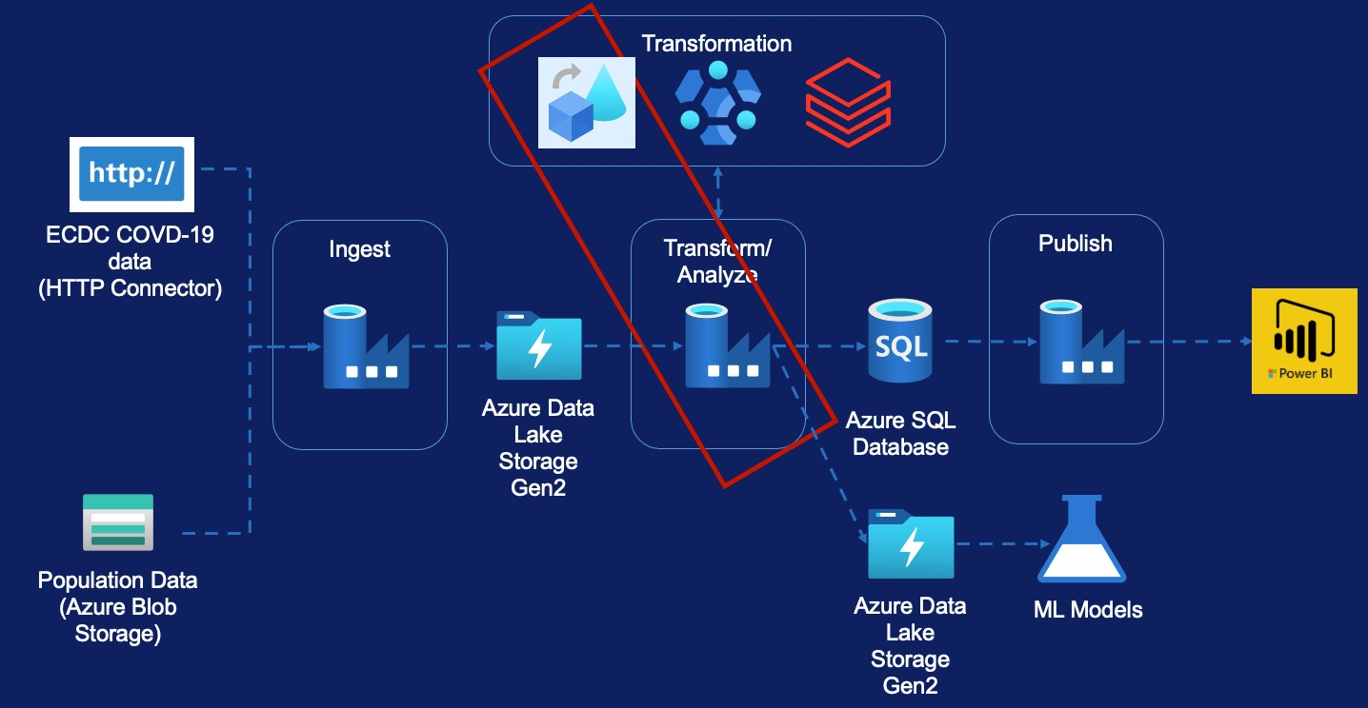
Data Flow – Cases & Deaths Data
Data Flow Overview
Requirement
Source Transformation Filter Transformation Select Transformation Pivot Transformation Lookup Transformation Sink Transformation Create Pipeline

Slide 80
Data Flows

Slide 81
Code free data transformations
Data Flows
Executed on Data Factory managed Databricks Spark clusters
Features
Benefits from Data factory scheduling and monitoring capabilities.

Slide 82
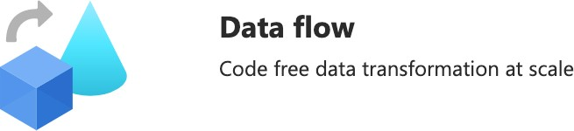
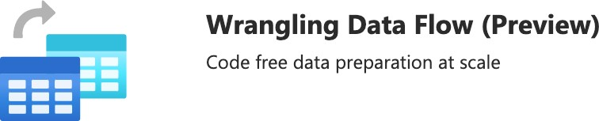
Data Flows
Types

Slide 83
Only available in some regions
https://docs.microsoft.com/en-us/azure/data-factory/concepts-data-flow- overview#available-regions
Limited set of connectors available
https://docs.microsoft.com/en-us/azure/data-factory/data-flow-source#supported- sources
Data Flows
Not suitable for very complex logic
Limitations

Slide 84

Data Flows

Slide 85
Transform Cases & Deaths Data

Slide 86

Transform Cases & Deaths Data
Europe Only
Raw File from ECDC
Transformed File
Column Name
country
country_code
continent
population
indicator
daily_count
date
rate_14_day
source
Column Name
country
country_code_2_digit(Lookup)
country_code_3_digit
population
cases_count
deaths_count
reported_date
source

Slide 87






Transform Cases & Deaths Data
Europe Only
Raw File from ECDC
Transformed File
Column Name
country
country_code
continent
population
indicator
daily_count
date
rate_14_day
source
Column Name
country
 | country_code_2_digit(Lookup)
country_code_3_digit
population
cases_count
deaths_count
reported_date(Rename)
source

Slide 88
Data Flows (2) - Module Overview (Hospital Admissions File)

Slide 89
Data Flow – Cases & Deaths Data
Requirement
Source Transformation Select Transformation Lookup Transformation Pivot Transformation Sink Transformation
Conditional Split Transformation Derived Column Transformation Aggregate Transformation
Sort Transformation Join Transformation
Create Pipeline

Slide 90
Hospital Admissions Data

Slide 91
Hospital Admissions Data
Column Name
country
country_code_2_digit(Lookup)
country_code_3_digit(Lookup)
Population(Lookup)
reported_date
hospital_occupancy_count
icu_occupancy_count
source
Column Name
country
country_code_2_digit(Lookup)
country_code_3_digit(Lookup)
population(Lookup)
reported_year_week(transformed)
reported_week_start_date(Lookup)
reported_week_end_date(Lookup)
new_hospital_occupancy_count
new_icu_occupancy_count
Source
Transformed Daily File
Raw File from ECDC
Column Name
country
indicator
date
year_week
value
source
url
Transformed Weekly File

Slide 92
Hospital Admissions Data
Column Name
country
country_code_2_digit(Lookup)
country_code_3_digit(Lookup)
Population(Lookup)
reported_date
hospital_occupancy_count
icu_occupancy_count
source
Column Name
country
country_code_2_digit(Lookup)
country_code_3_digit(Lookup)
population(Lookup)
reported_year_week(transformed)
reported_week_start_date(Lookup)
reported_week_end_date(Lookup)
new_hospital_occupancy_count
new_icu_occupancy_count
Source
Transformed Daily File
Raw File from ECDC
Column Name
country
indicator
date
year_week
value
source
url
Transformed Weekly File

Slide 93
Source Transformation
Assignment

Slide 94

Select Transformation
Assignment
Remove url
Rename date to reported_date
Rename year_week to reported_year_week

Slide 95
Lookup Transformation
Assignment
Lookup country file
Select only required fields (i.e. remove additional fields from lookup)

Slide 96

Pivot Transformation
Assignment

Slide 97
Hospital Admissions Data
Column Name
country
country_code_2_digit(Lookup)
country_code_3_digit(Lookup)
Population(Lookup)
reported_date
hospital_occupancy_count
icu_occupancy_count
source
Column Name
country
country_code_2_digit(Lookup)
country_code_3_digit(Lookup)
population(Lookup)
reported_year_week(transformed)
reported_week_start_date(Lookup)
reported_week_end_date(Lookup)
new_hospital_occupancy_count
new_icu_occupancy_count
Source
Transformed Daily File
Raw File from ECDC
Column Name
country
indicator
date
year_week
value
source
url
Transformed Weekly File

Slide 98
Hospital Admissions Data
Column Name
country
country_code_2_digit(Lookup)
country_code_3_digit(Lookup)
Population(Lookup)
reported_date
hospital_occupancy_count
icu_occupancy_count
source
Column Name
country
country_code_2_digit(Lookup)
country_code_3_digit(Lookup)
population(Lookup)
reported_year_week(transformed)
reported_week_start_date(Lookup)
reported_week_end_date(Lookup)
new_hospital_occupancy_count
new_icu_occupancy_count
Source
Transformed Daily File
Raw File from ECDC
Column Name
country
indicator
date
year_week
value
source
url
Transformed Weekly File

Slide 99
Select & Sink Transformation
Assignment

Slide 100
Hospital Admissions Data
Column Name
country
country_code_2_digit(Lookup)
country_code_3_digit(Lookup)
Population(Lookup)
reported_date
hospital_occupancy_count
icu_occupancy_count
source
Column Name
country
country_code_2_digit(Lookup)
country_code_3_digit(Lookup)
population(Lookup)
reported_year_week(transformed)
reported_week_start_date(Lookup)
reported_week_end_date(Lookup)
new_hospital_occupancy_count
new_icu_occupancy_count
Source
Transformed Daily File
Raw File from ECDC
Column Name
country
indicator
date
year_week
value
source
url
Transformed Weekly File

Slide 101
Hospital Admissions Data
Column Name
country
country_code_2_digit(Lookup)
country_code_3_digit(Lookup)
Population(Lookup)
reported_date
hospital_occupancy_count
icu_occupancy_count
source
Column Name
country
country_code_2_digit(Lookup)
country_code_3_digit(Lookup)
population(Lookup)
reported_year_week(transformed)
reported_week_start_date(Lookup)
reported_week_end_date(Lookup)
new_hospital_occupancy_count
new_icu_occupancy_count
Source
Transformed Daily File
Raw File from ECDC
Column Name
country
indicator
date
year_week
value
source
url
Transformed Weekly File

Slide 102
Data Flow Execution
Assignment

Slide 103
HDInsight Activity - Module Overview (Testing File)

Slide 104
HDInsight Activity – Testing File
Transformation
ECDC COVD-19
data (HTTP Connector)
Ingest
Transform/ Analyze
Publish
Azure Data Lake Storage Gen2
Azure SQL Database
Population Data (Azure Blob Storage)
Azure Data Lake Storage Gen2
ML Models

Slide 105
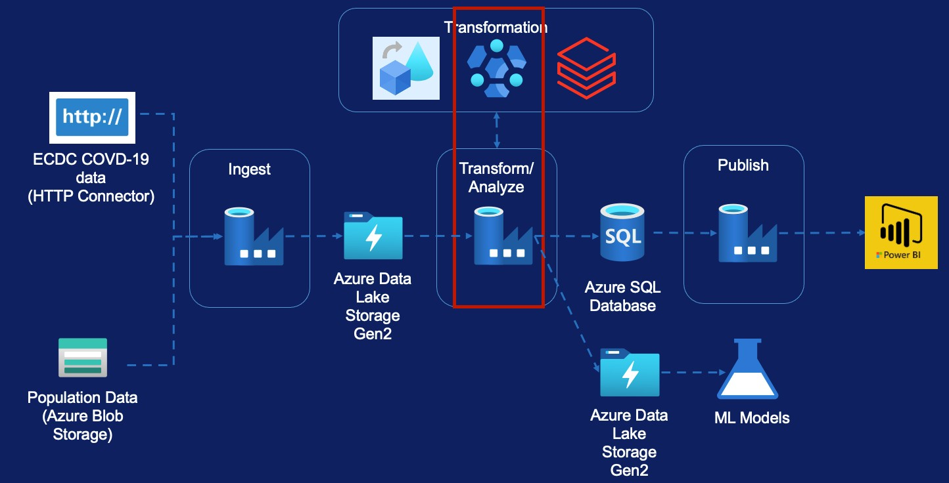
HDInsight Activity – Testing File
Creating HDInsight Cluster
HDInsight UI Overview Transformation Requirement Hive Script Walk-through Creating Pipeline
Delete HDInsight Cluster

Slide 106
Creating HDInsight Cluster

Slide 107
Testing Data

Slide 108
Testing Data
Transformed File
Raw File from ECDC
Column Name
country
country_code_2_digit (lookup)
country_code_3_digit(lookup)
reported_year_week
reported_week_start_date(lookup)
reported_week_end_date(lookup)
new_cases
test_done
population
testing_rate
positivity_rate
testing_data_source
Column Name
country
country_code (Remove)
Year_week
new_cases
test_done
population
testing_rate
positivity_rate
testing_data_source

Slide 109
Databricks Activity - Module Overview (Population File)

Slide 110
Databricks Activity – Population File
Transformation
ECDC COVD-19
data (HTTP Connector)
Ingest
Transform/ Analyze
Publish
Azure Data Lake Storage Gen2
Azure SQL Database
Population Data (Azure Blob Storage)
Azure Data Lake Storage Gen2
ML Models

Slide 111

Databricks Activity – Population File
Create Databricks Service
Create Databricks Cluster Mount Storage Accounts Transformation Requirements Creating Pipeline

Slide 112

Databricks Environment Set-up

Slide 113
Creating Databricks Service

Slide 114
Creating Databricks Cluster

Slide 115
What is a cluster?
Driver Node
Databricks Runtime
Worker Node
Worker Node
Worker Node

Slide 116
Cluster Types
All Purpose/ Interactive Clusters
Job Clusters

Slide 117
Mounting Data Lake Storage

Slide 118
Mounting Data Lake Storage
Create Azure Service Principal
Grant access for data lake to Azure Service Principal Create the mount in databricks using Service Principal

Slide 119
Transform Population By Age Data

Slide 120
Transform Population By Age Data
Raw File
Transformed File
Column Name
indic_de,geo\time
2008
2009
2010
2011
…
….
2018
2019
Column Name
Country (Lookup)
country_code_2_digit(Substr)
country_code_3_digit(Lookup)
population(Lookup)
age_group_0_14
age_group_25_49
age_group_50_64
age_group_65_79
age_group_80_max

Slide 121
Transform Population By Age Data
Data Factory Pipeline

Slide 122
Copy Data to Azure SQL

Slide 123
Copy Data to SQL
Transformation
ECDC COVD-19
data (HTTP Connector)
Ingest
Transform/ Analyze
Publish
Azure Data Lake Storage Gen2
Azure SQL Database
Population Data (Azure Blob Storage)
Azure Data Lake Storage Gen2
ML Models

Slide 124

Copy Data to SQL
Copy Cases & Deaths
Copy Hospital Admissions Copy Testing

Slide 125
Copy Activity – Data Lake to SQL
Cases and Deaths Data

Slide 126
Copy Activity – Data Lake to SQL
Hospital Admissions Daily Data
Assignment

Slide 127
Copy Activity – Data Lake to SQL
Testing Data

Slide 128

Data Orchestration

Slide 129
Data Orchestration Requirements
Pipeline executions are full automated
Pipelines run at regular intervals or on an event occurring
Activities only run once the upstream dependency has been satisfied Easier to monitor for execution progress and issues

Slide 130
Data Factory Capability
Dependency between activities inside a pipeline
Dependency between pipelines within a parent pipeline Dependency between triggers [Only tumbling window triggers] Custom-made Solution

Slide 131
Data Orchestration
Option 1 – Parent Pipeline

Slide 132
Data Orchestration
Option 2 – Trigger Dependency

Slide 133
Azure Data Factory - Monitoring

Slide 134

Azure Data Factory - Monitoring
What to Monitor
Data Factory Monitoring Creating Alerts
Recovery From Failure Reporting on Metrics Azure Monitor Introduction Log Analytics
Azure Data Factory Analytics

Slide 135
Monitoring

Slide 136
What do we want to monitor
Azure Data Factory Resource
Integration runtime Trigger runs Pipeline runs Activity runs

Slide 137
Data Factory Monitor
Ability to monitor status of pipeline/ triggers
Can be used to re-run failed pipelines/ triggers
Ability to send alerts from base level metrics Provides base level metrics and logs Pipeline runs are stored only for 45 days

Slide 138
Azure Monitor
Ability to route the diagnostic data to other storage solutions
Provides richer diagnostic data
Ability to write complex queries and custom reporting Ability to report across multiple data factories

Slide 139
Data Factory Monitor

Slide 140
Azure Monitor

Slide 141
Reporting via Power BI

Slide 142
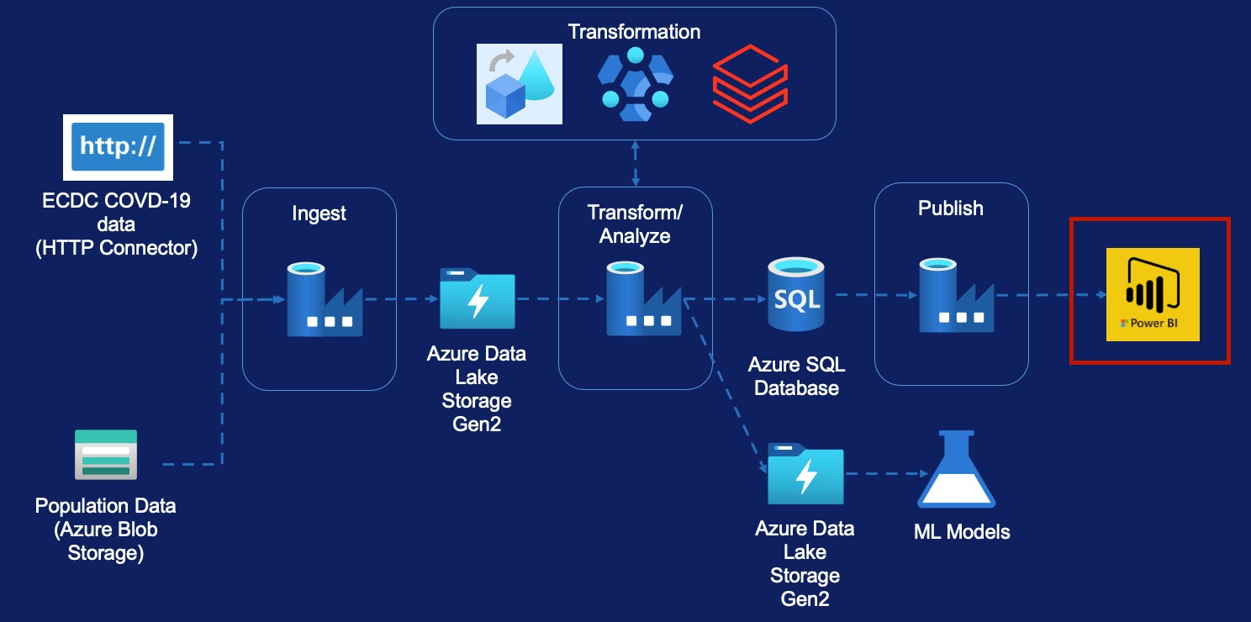
Reporting via Power BI
Introduction to Power BI Desktop
Review the Covid-19 pre-built Report

Slide 143
Power BI Desktop Overview

Slide 144
Congratulations! &
Thank you

